Slide 1
WIA1005 Network Technology Foundation
Chapter 4
Network and Transport Layer

Slide 2
Contents
Network Layer
Routing
ICMPv4
Transport Layer
Transmission Control Protocol (TCP)
User Datagram Protocol (UDP)

Slide 3
Network Layer
The network layer allow end devices to exchange data across the network. It consists of four basic processes:
  Addressing end devices - End devices must be configured with a unique IP address for identification on the network.
  Encapsulation - The network layer adds IP header to the PDU receive from the transport layer.
  Routing - The network layer provides services to direct packets to a destination host on another network.
  De-encapsulation - When the packet arrives at the destination host, the IP header is removed from the packet. and passed up to the transport layer.

Slide 4
Network Layer
Two common network layer protocols
  Internet Protocol version 4 (IPv4)
  Internet Protocol version 6 (IPv6)
The basic characteristics of IP are:
  Connectionless - No connection with the destination is established before sending data packets. It is similar to sending a letter to someone without notifying the recipient in advance
  Best Effort (unreliable) - Packet delivery is not guaranteed. Senders are unaware whether destination devices are on when sending packets.
  Media Independent - Operation is independent of the medium carrying the data.

Slide 5
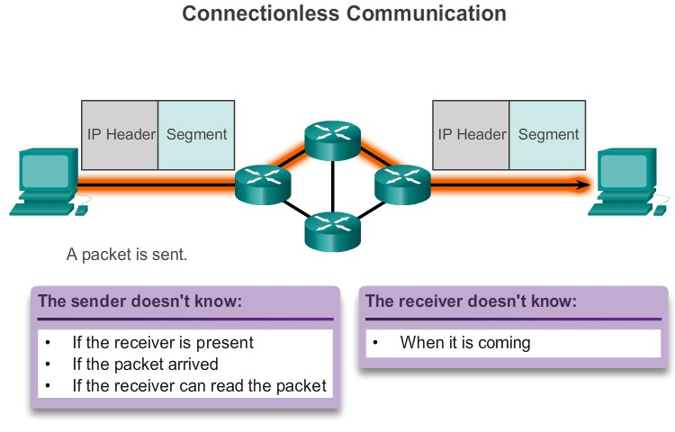
Network Layer

Slide 6
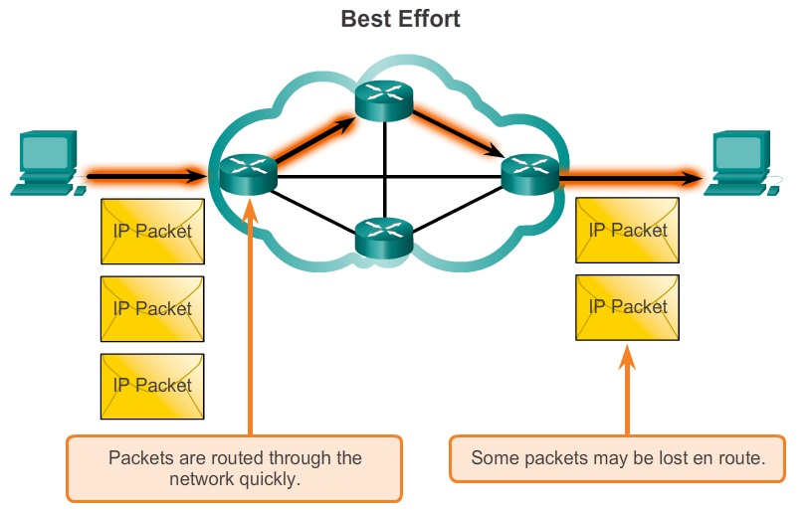
Network Layer

Slide 7
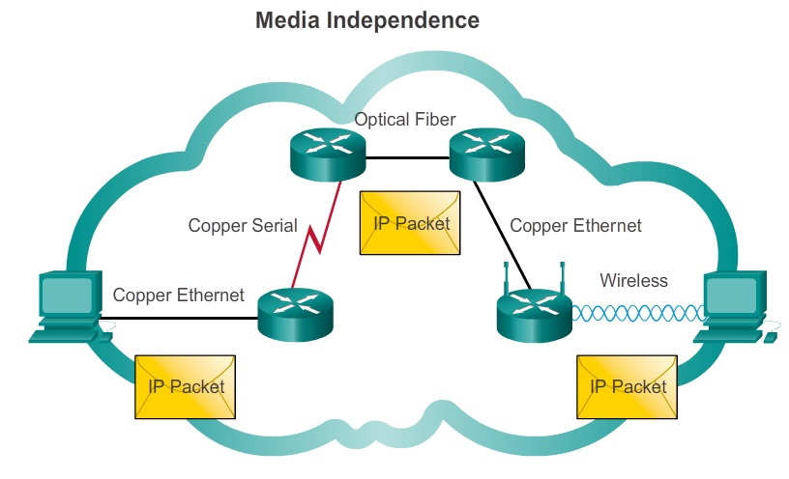
Network Layer

Slide 8
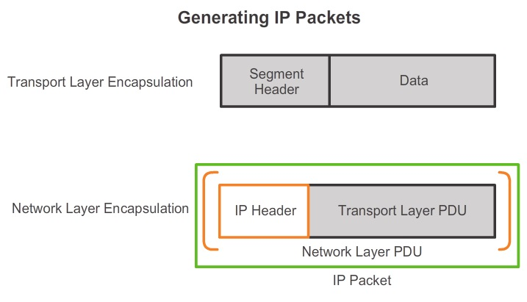
Network Layer

Slide 9
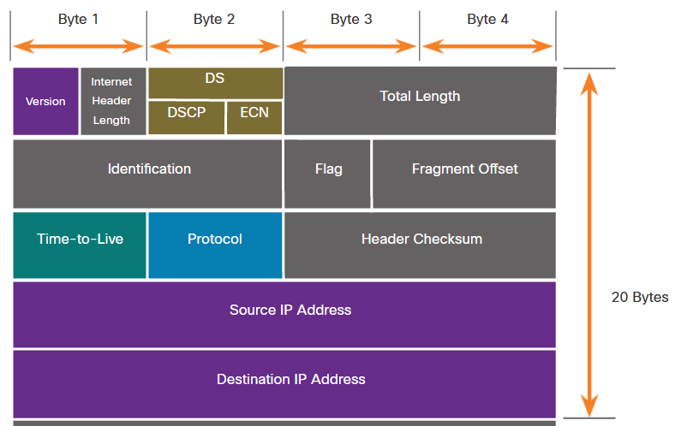
Network Layer
IPv4 Header

Slide 10
Network Layer
IPv4 has three major issues:
  IP address depletion - IPv4 has a limited number of unique public IP addresses available.
  Lack of end-to-end connectivity - The sharing of public IP address cause an internal network host is hidden from outside world. This can be problematic for technologies that require end-to-end connectivity.
  Increased network complexity – Network Address Translation in IPv4 creates additional complexity in the network with additional latency and making troubleshooting more difficult.

Slide 11
Network Layer
IPv6 overcomes the limitations of IPv4:
  Increased address space - IPv6 addresses are based on 128-bit
  Improved packet handling - The IPv6 header has been simplified with fewer fields.
  Eliminates the need for NAT - With such a large number of public IPv6 addresses, Network Address Translation (NAT) is not needed.
  Integrated security - IPv6 natively supports authentication and privacy capabilities.

Slide 12
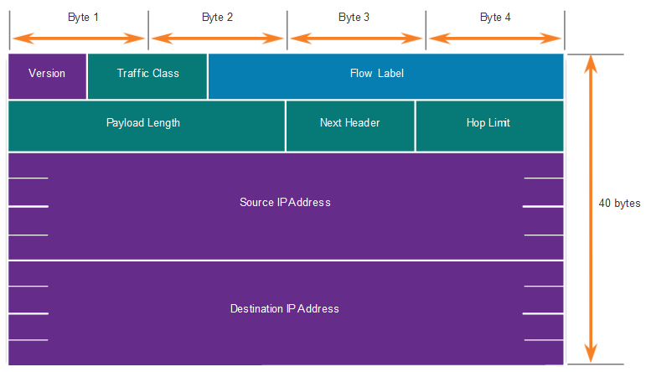
Network Layer
IPv6 Header

Slide 13
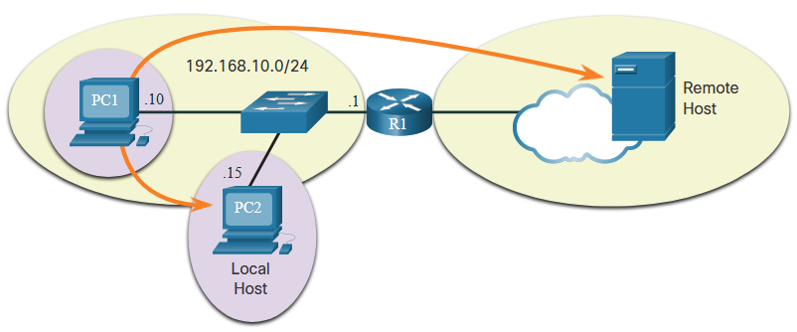
Routing
A host can send a packet to the following:
  Itself – ping 127.0.0.1 or ::/1 (loopback interface - tests the TCP/IP protocol stack on the host)
  Local host - This is a destination host that is on the same local network as the sending host.
  Remote host - This is a destination host on a remote network.

Slide 14
Routing
The host determines whether the destination IP address is on the same network by
  Checking its own subnet mask along with its own IPv4 address and the destination IPv4 address. (IPv4)
  In IPv6 - The local router advertises the local network address (prefix) to all devices on the network.
If the host is sending a packet to a device on a different IP network, then the host must forward the packet through the intermediate device to the default gateway. The default gateway is the device that routes traffic from the local network to devices on remote networks.

Slide 15
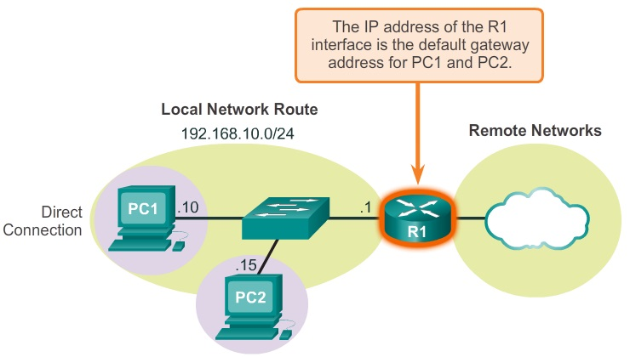
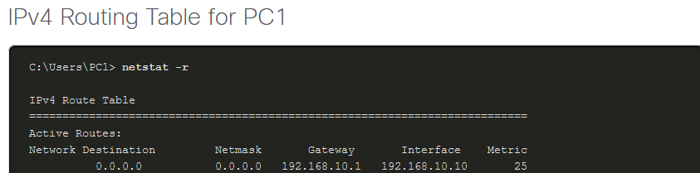
Routing

Slide 16
Routing
Router is the device that connects to multiple networks. Each router contains the routing table that stores three types of route entries:
Directly-connected networks - These network route entries are active router interfaces.
Remote networks - These network route entries are connected to other routers. Routers learn about remote networks either by manual configuration or by exchanging route information using a dynamic routing protocol.
Default route - The default route is used when there is no better (longer) match in the IP routing table.

Slide 17
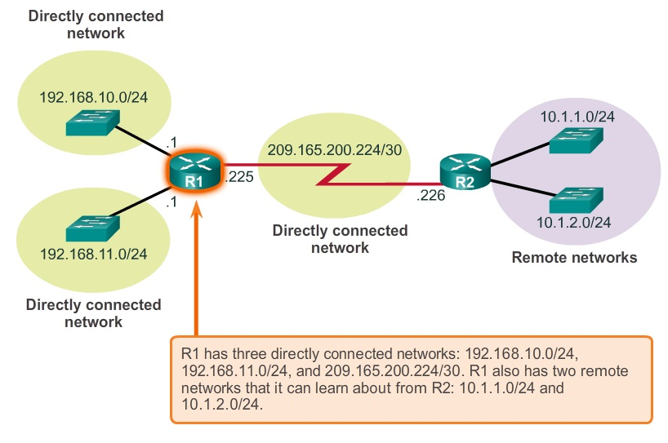
Routing

Slide 18
Routing
Static routes are route entries that are manually configured. If there is a change in the network topology, the static route is not automatically updated and must be manually reconfigured.
A dynamic routing protocol allows the routers to automatically learn about remote networks, including a default route, from other routers. If there is a change in the network topology, the routers will automatically adjust and attempt to find a new best path.

Slide 19
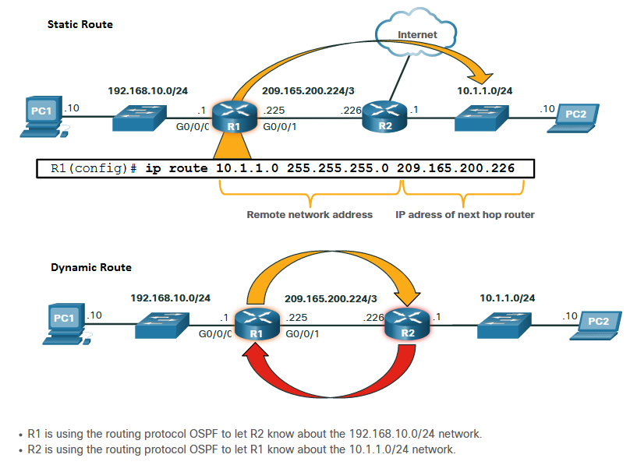
Routing

Slide 20
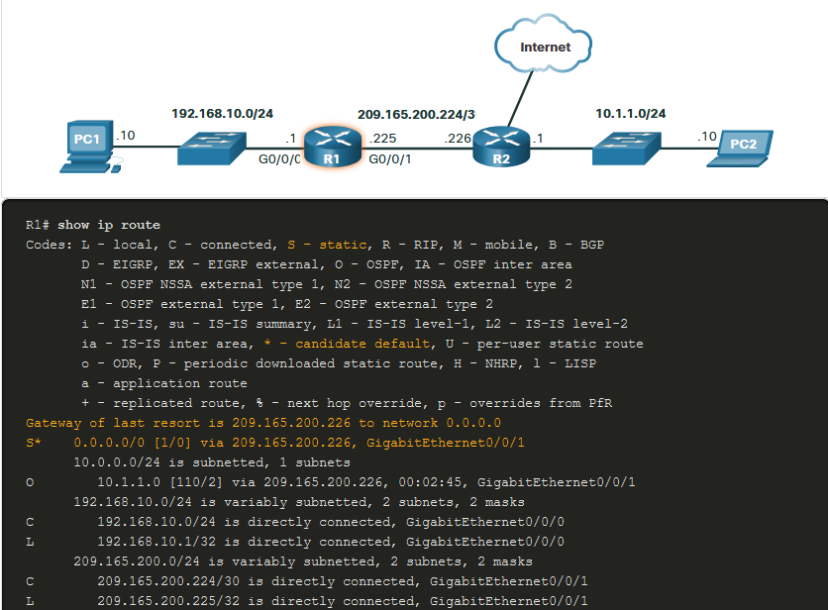

Slide 21
ICMPv4
An ICMP Echo Message can be used to test the reachability of a host on an IP network. The local host sends an ICMP Echo Request to a host. If the host is available, the destination host responds with an Echo Reply. (ping command)
When a host or gateway receives a packet that it cannot deliver, it can use an ICMP Destination Unreachable message to notify the source that the destination or service is unreachable.
An ICMPv4 Time Exceeded message is used by a router to indicate that a packet cannot be forwarded because the Time to Live (TTL) field of the packet was decremented to 0. (routing loop)

Slide 22
ICMPv4
Ping is the command the used for connectivity test. Type of connectivity tests performed include the following:
  Pinging the local loopback
  Pinging the default gateway
  Pinging the remote host
Traceroute (tracert) is a utility that generates a list of hops that were successfully reached along the path. This list can provide important verification and troubleshooting information. If the data reaches the destination, then the trace lists the interface of every router in the path between the hosts.

Slide 23
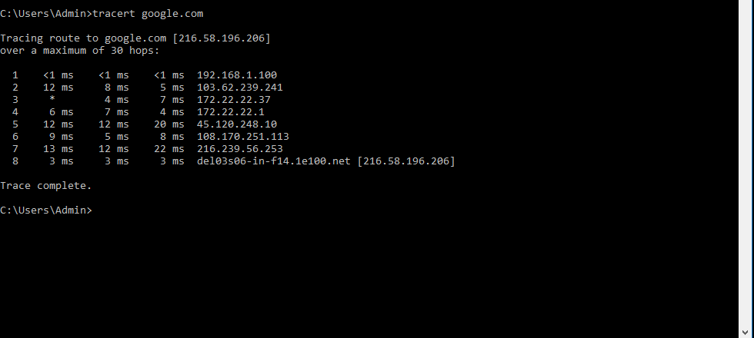
ICMPv4
Traceroute sends three separate packets. The round-trip time (RTT) is the time a packet takes to reach the remote host and for the response from the host to return. An asterisk (*) is used to indicate a lost or unreplied packet.

Slide 24
Transport Layer
The transport layer is responsible for establishing a temporary communication session between two applications and delivering data between them.
The transport layer provides for the segmentation of data, and the controls necessary to reassemble these segments into the various communication streams.
The transport layer identifies the proper application for each communication stream.
TCP is considered a reliable transport protocol.
  Tracking transmitted data segments
  Acknowledging received data
  Retransmitting any unacknowledged data

Slide 25
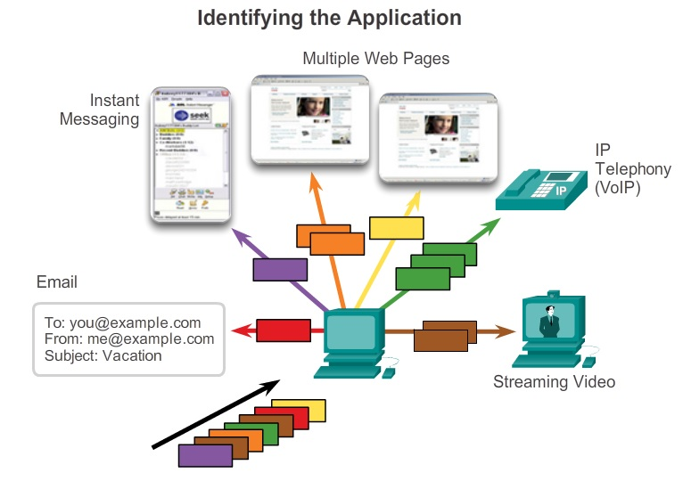
Transport Layer

Slide 26
Transport Layer
UDP provides just the basic functions for delivering data segments between the appropriate applications, with very little overhead and data checking.
Both TCP and UDP are valid transport protocols. Depending upon the application requirements, either one, or sometimes both, of these transport protocols can be used.
For some applications, segments must arrive in a very specific sequence to be processed successfully. With other applications, all data must be fully received before any of it is considered useful. In other cases, an application can tolerate some data loss during transmission over the network, but delays in transmission are unacceptable.

Slide 27
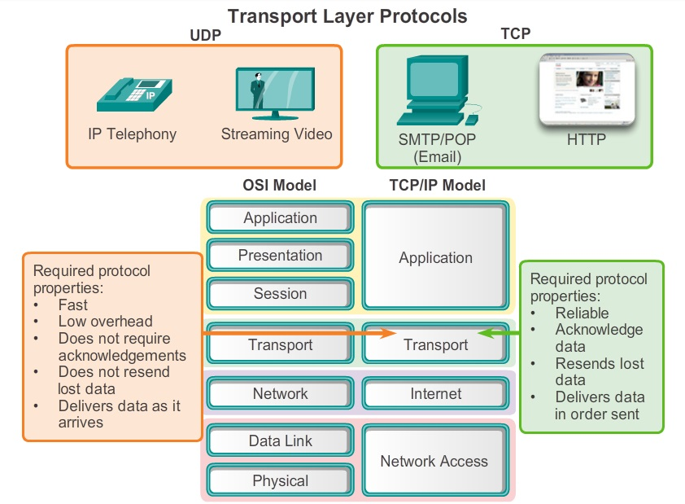
Transport Layer

Slide 28
Transport Layer
When a message is delivered using either TCP or UDP, the protocols and services requested are identified by a port number.
A port number is a numeric identifier within each segment that is used to keep track of specific conversations and destination services requested.
Destination Port
  The client places a destination port number in the segment to tell the destination server what service is being requested. For example, port 80 refers to HTTP or web service.

Slide 29
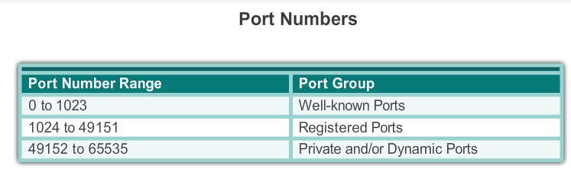
Transport Layer
Source Port
  The source port number is randomly generated by the sending device to identify a conversation between two devices. This allows multiple conversations to occur simultaneously.
The source and destination ports are placed within the segment. The segments are then encapsulated within an IP packet.

Slide 30
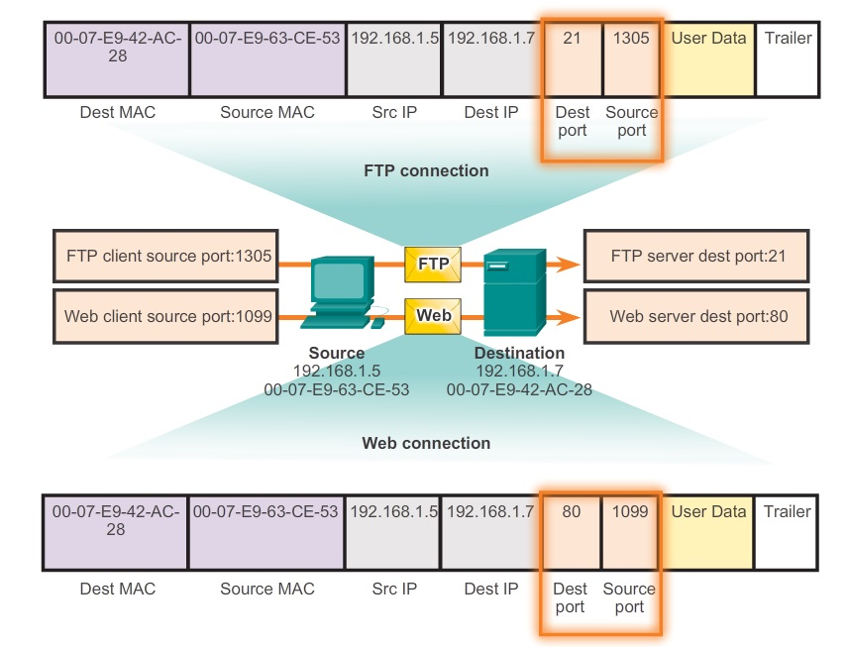
Transport Layer

Slide 31
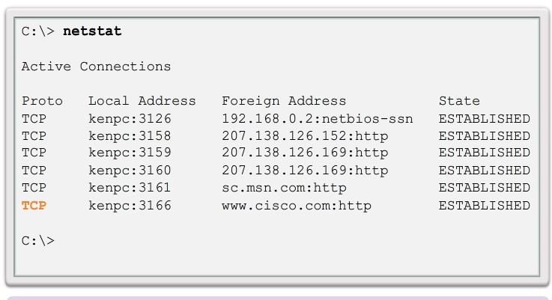
Transport Layer

Slide 32
Transmission Control Protocol (TCP)
Establishing a Session
  TCP is a connection-oriented protocol that negotiates and establishes a permanent connection (or session) between source and destination devices prior to forwarding any traffic.
Reliable Delivery
  TCP can ensure that all pieces reach their destination by having the source device retransmit lost or corrupted data.
Same-Order Delivery
  By numbering and sequencing the segments, TCP can ensure that these segments are reassembled into the proper order.

Slide 33
Transmission Control Protocol (TCP)
Flow Control
  Network hosts have limited resources, such as memory or bandwidth. When TCP is aware that these resources are overtaxed, it can request that the sending application reduce the rate of data flow.
  Flow control can prevent the loss of segments on the network and avoid the need for retransmission.
TCP incurs additional overhead. Each TCP segment has 20 bytes of overhead in the header encapsulating the application layer data. This is considerably more than a UDP segment, which only has 8 bytes of overhead

Slide 34
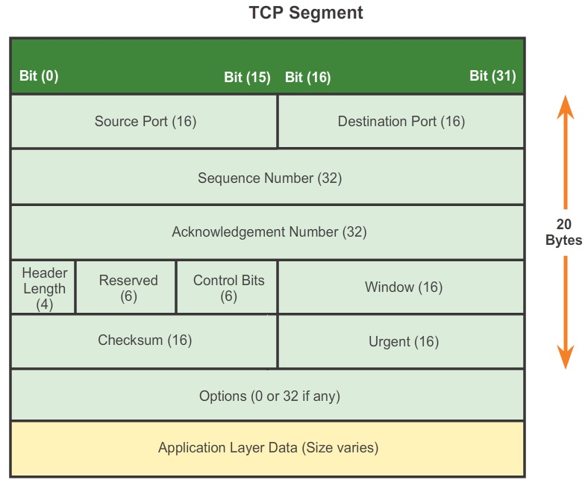
Transmission Control Protocol (TCP)

Slide 35
Transmission Control Protocol (TCP)
To establish the connection, TCP perform a three-way handshake.
  A TCP client begins the three-way handshake by sending a segment with the synchronize sequence number (SYN) control flag.
  The TCP server acknowledge the receipt of the SYN segment from the client to establish the session from the client to the server. The server sends a segment back to the client with the acknowledgement (ACK) flag. The server also send a SYN flag to the client.
  Finally, the TCP client responds with a segment containing an ACK that is the response to the TCP SYN sent by the server.

Slide 36
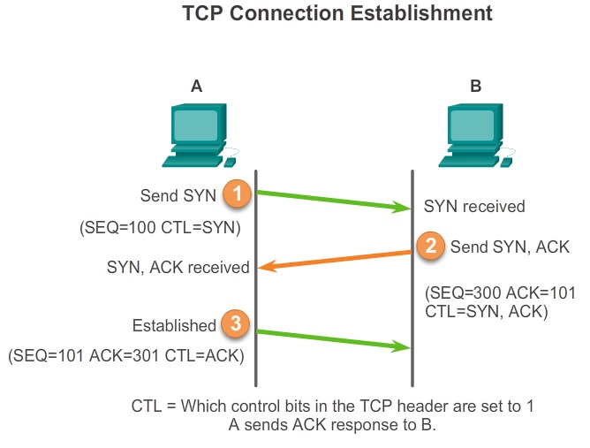
Transmission Control Protocol (TCP)

Slide 37
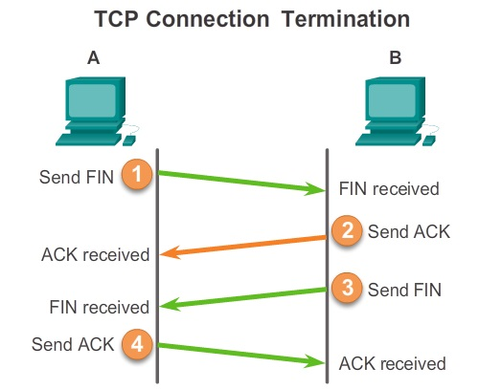
Transmission Control Protocol (TCP)
To close a connection, the Finish (FIN) control flag must be set in the segment header. To end each one-way TCP session, a two-way handshake is used, consisting of a FIN segment and an ACK segment.

Slide 38
Transmission Control Protocol (TCP)
When services send data using TCP, segments may arrive at their destination out of order.
The receiving TCP process places the data from a segment into a receiving buffer. Segments are placed in the proper sequence number order and passed to the application layer when reassembled.

Slide 39
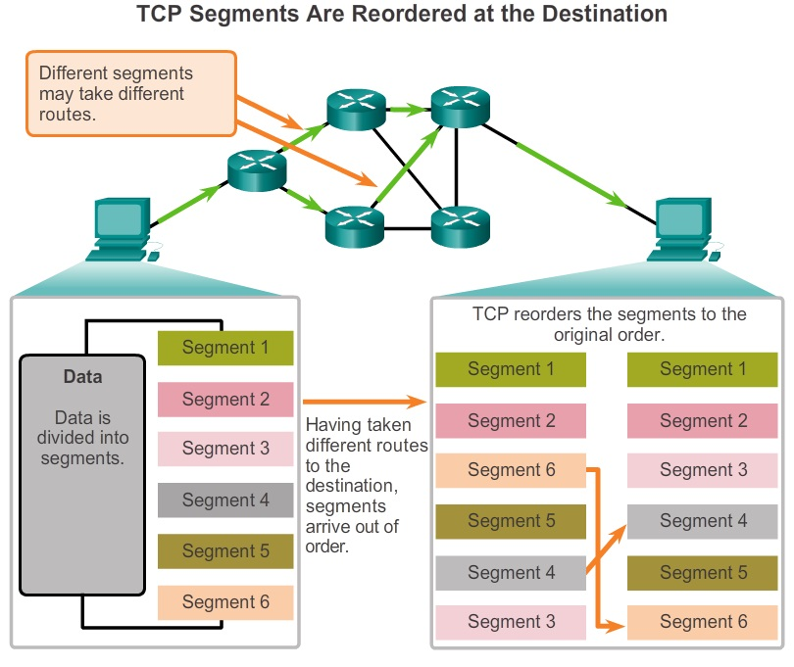
Transmission Control Protocol (TCP)

Slide 40
Transmission Control Protocol (TCP)
One of the functions of TCP is ensuring that each segment reaches its destination. The TCP services on the destination host acknowledge the data that it has received by the source application.
When TCP at the source host has not received an acknowledgement after a predetermined amount of time, it returns to the last ACK number received and retransmits the data from that point forward.
The amount of data that a source can transmit before an acknowledgement must be received is called the window size, which is a field in the TCP header that enables the management of lost data and flow control.

Slide 41
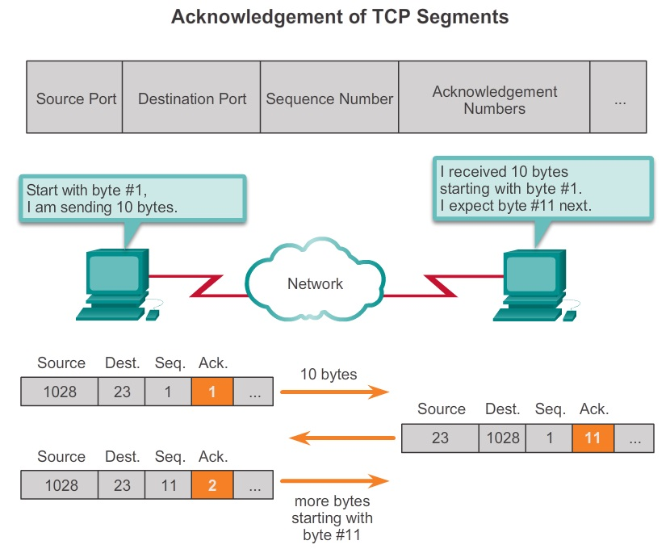
Transmission Control Protocol (TCP)

Slide 42
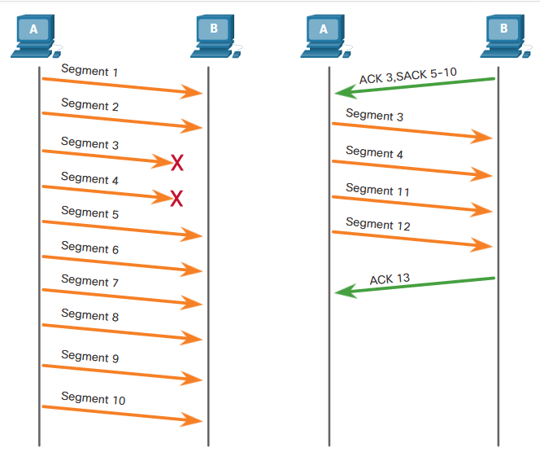
Transmission Control Protocol (TCP)

Slide 43
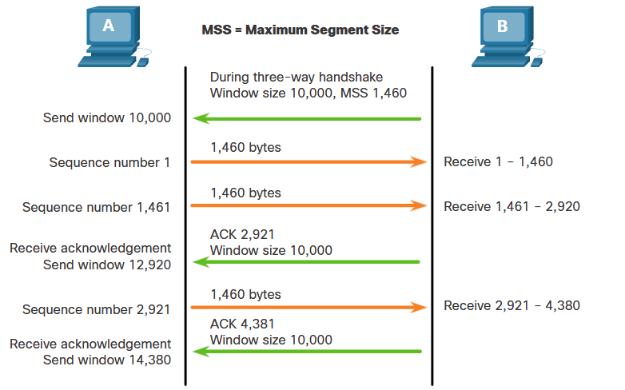
Transmission Control Protocol (TCP)

Slide 44
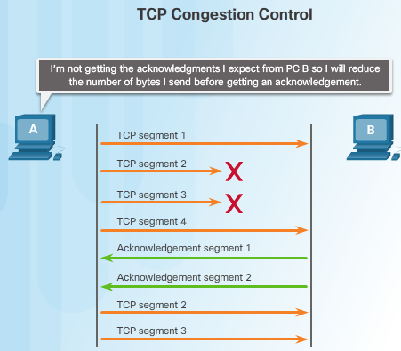
Transmission Control Protocol (TCP)

Slide 45
Transmission Control Protocol (TCP)
Some examples of well-known applications that use TCP include:
  Hypertext Transfer Protocol (HTTP)
  File Transfer Protocol (FTP)
  Simple Mail Transfer Protocol (SMTP)
  Telnet

Slide 46
User Datagram Protocol (UDP)
Connectionless
  UDP does not establish a connection between the hosts before data can be sent and received.
Unreliable Delivery
  UDP does not provide services to ensure that the data will be delivered reliably.
No Ordered Data Reconstruction
  Occasionally data is received in a different order than it was sent. UDP does not provide any mechanism for reassembling the data in its original sequence.
No Flow Control
  There are no mechanisms within UDP to control the amount of data transmitted by the source.

Slide 47
User Datagram Protocol (UDP)
UDP’s low overhead data delivery makes it an ideal transport protocol for applications that can tolerate some data loss.
The pieces of communication in UDP are called datagrams. These datagrams are sent as best effort by the transport layer protocol.
A few applications that use UDP are Domain Name System (DNS), video streaming, Voice over IP (VoIP), TFTP and SNMP.

Slide 48
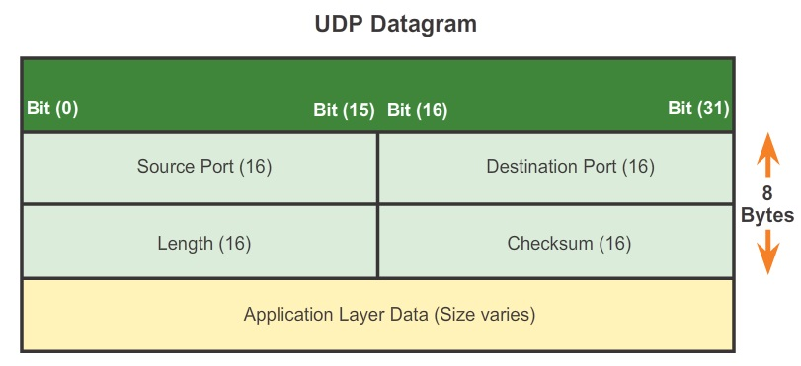
User Datagram Protocol (UDP)

